Slide 1
DSO Chatbot PresentationMarcus Yeo

Slide 2
Table of contents
01
02
Overview
Topic Research
03
04
Tech-Stack
Live Demo!

Slide 3
01
Overview

Slide 4




Two columns
Introduction!
Marcus

Slide 5
Two columns
The Goal:
User-Friendly
Abstraction
Create an Intelligent Chatbot Assistant for the ES Division as part of a larger application
Used to handle queries and deliver insights from a database backed analytical tool
All achieved without the need for complex UI/UX processes

Slide 6
Two columns
Basic Functionalities:
Perform data-retrieval via SQLite Database
Basic conversations with users
Different user privileges

Slide 7
02
Topic Research

Slide 8





Two columns
Basic Research:
Able to access SQLite Database
Operational offline
Keyword Search
Natural Language Processing (NLP)
Natural Language Units (NLU)

Slide 9




Two columns
Choosing an NLU:
Open-market NLU Frameworks

Slide 10



Two columns
Challenges faced:
Lack of experience with Rasa and NLP
Connecting Rasa and the WPF app
Displaying results as a table in WPF

Slide 11
03
Tech Stack

Slide 12



Two columns
Whats inside:
NLU
Database
Front-End

Slide 13
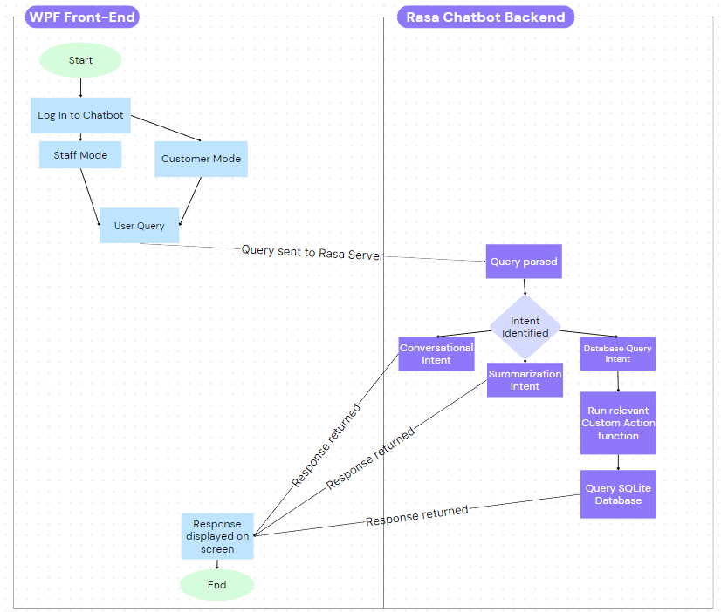
Two columns
Workflow Diagram:

Slide 14



Two columns
As an example...
Staff/Customer Modes
Database tracking products & transactions
Grocery Store Chatbot
Handle user queries

Slide 15
04
Live Demo!

Slide 16
Two columns
Live Demo
Greet bot
Ask product (what are products avail + brand)
Clear all
Find all products
Find all transactions
Clear all
Find all information
Find all brands
Find transactions tag
Find products tag
Find tag
Page redirect
Find top
End bot
End app

